Slide 1
Understanding the Dignity for All Students Act (DASA)
Daniel Stadtmiller
Director of Health, PE, and Athletics
DASA Coordinator - JEHS

Slide 2
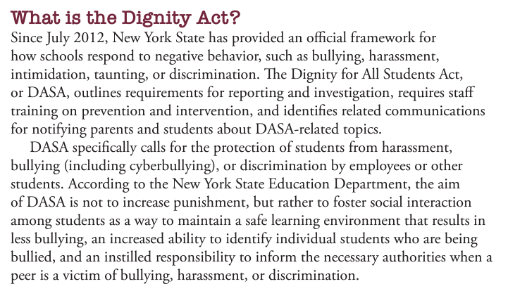
What is DASA?

Slide 3
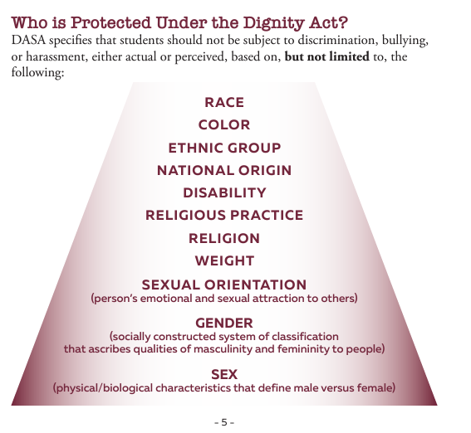

Slide 4
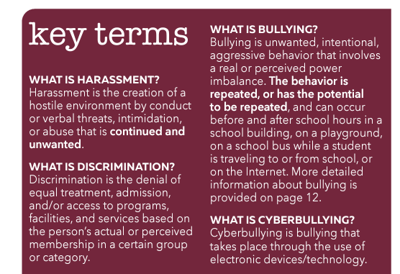

Slide 5
Bullying can be…
Physical - hitting, kicking, spitting, pushing and/or taking personal belongings
Verbal - taunting, malicious teasing, name calling and/or making threats
Psychological - spreading rumors, manipulating social relationships and/or engaging in social exclusion, extortion, and intimidation
Cyber - occurs when harassment or bullying happens through any form of electronic communication
Cyberbullying can occur off campus and is punishable in-school if it could cause a disruption to the building.

Slide 6
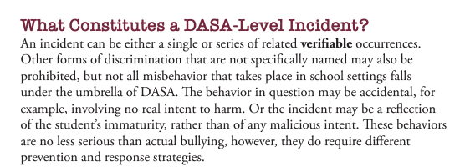
What is considered a DASA-Level Incident?

Slide 7
How do I file a DASA Complaint?
DASA Complaint Forms are available online (DASA Page) and in each buildings main office and guidance office. Forms should be turned into the building principal or DASA Coordinator.
DASA Coordinators:
EE - Rob McIntyre and Nicole Bloodgood
MS/JEDIS - Meghan Fedigan
HS - Dan Stadtmiller and Laurie Spencer

Slide 8
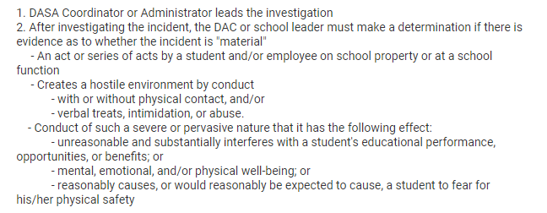
What happens when I file a DASA?

Slide 9
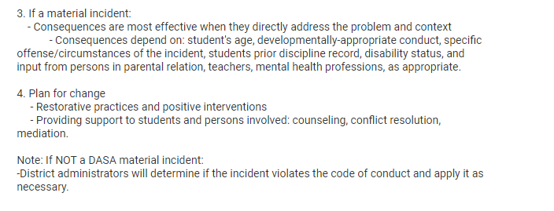
What happens when I file a DASA?

Slide 10
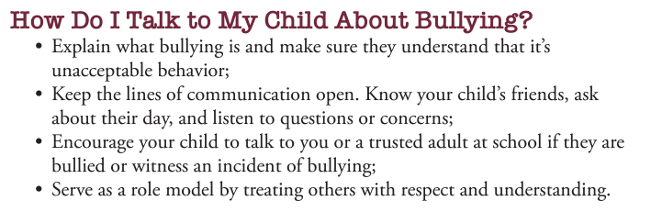
How can I help as a parent?

Slide 11
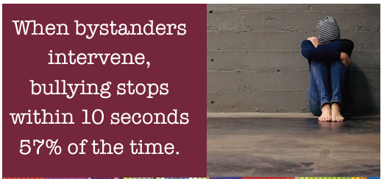

Slide 12
Questions?
Contact Information:
Dan Stadtmiller
Director of Health, PE, and Athletics
DASA Coordinator
315-689-8510 x 1007
dstadtmiller@jecsd.org

